Slide 1

Recursion Tree Method
CSA0606
DESIGN AND ANALYSIS OF ALGORITHM
BY
VANSH MEHTA – 192411005
Notes:
1

Slide 2


INTRODUCTION
• Recurrence defines recursive running time • Recursion tree expands calls level by level • Sum all level costs
What is Recurrence?
A recurrence relation defines the running time of a recursive algorithm.
The Recursion Tree Method solves a recurrence by:
Expanding recursive calls into a tree.
Finding the cost at each level.
Adding all level costs.
Determining the total time complexity.
Applications
Merge Sort
Quick Sort
Divide and Conquer Algorithms

Slide 3
PROBLEM STATEMENT
Given T(n)=4T(n/2)+n
Construct recursion tree,
compute each level cost,
find total complexity and compare with Master Theorem.

Slide 4
ALGORITHM
Algorithm RecursionTree(n)
If n == 1
return 1
Divide problem into 4 subproblems
Solve each subproblem recursively
Combine results
Return total cost

Slide 5
Architecure Diagram
T(n)
Cost = n
/ | | \
T(n/2) T(n/2) T(n/2) T(n/2)
Each child cost = n/2
/|\...
16 nodes of T(n/4)
Each node cost = n/4

Slide 6
IMPLEMENTATION
#include<stdio.h>
int T(int n)
{
if(n<=1)
return 1;
return 4*T(n/2)+n;
}
int main()
{
printf("%d",T(8));
}

Slide 7
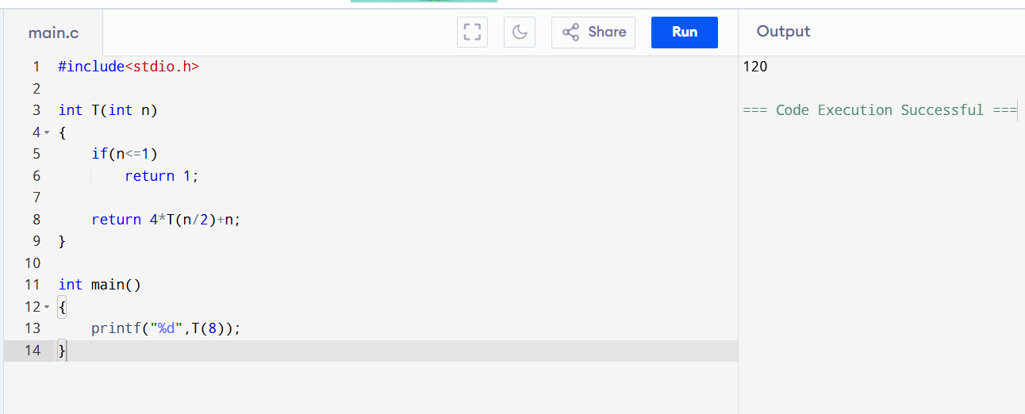
OUTPUT

Slide 8

COMPLEXITY ANALYSIS
Cost at each level
Level 0
$$n$$
Level 1
$$4×\frac{n}{2}=2n$$
Level 2
$$16×\frac{n}{4}=4n$$
Level k
$$2^{k}n$$
Height
$$\log_{2}n$$
Total Cost
$$n+2n+4n+⋯+n^{2}$$
Using GP Sum
$$T\left(n\right)=O\left(n^{2}\right)$$

Slide 9

CONCLUSION AND RESULT
Conclusion
Recursion Tree expands recursive calls level by level.
Total cost is obtained by summing all levels.
Complexity is
$$\boxed{Θ\left(n^{2}\right)}$$
Master Theorem confirms the same complexity.
References
Thomas H. Cormen et al., Introduction to Algorithms (CLRS).
Anany Levitin, Introduction to the Design and Analysis of Algorithms.
Course Notes.

Slide 10
THANK YOU

